Slide 1

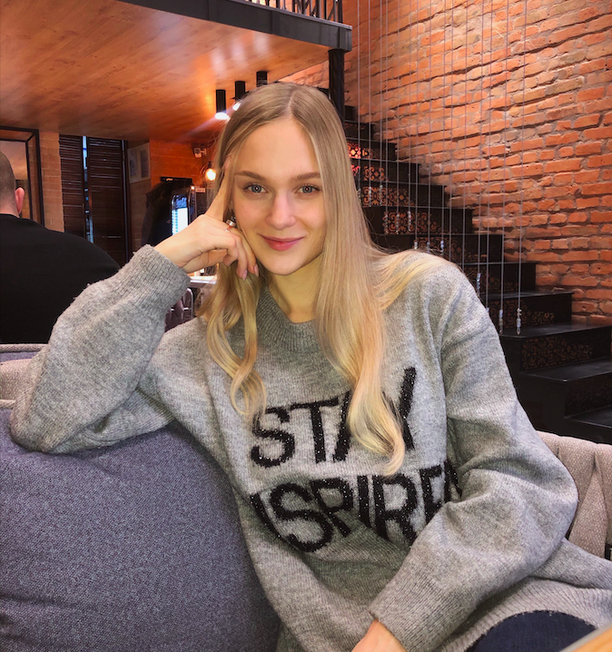
Daria Solodey
Methodist, course creator, English teacher

Slide 2
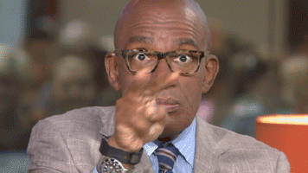
🔥
Our goal
Pass a job interview
Our rules:
Turn on your camera
Set up your microphone
Be active
Notes:
Если вам не хватило места, вы можете здесь написать развернутый комментарий.

Slide 3
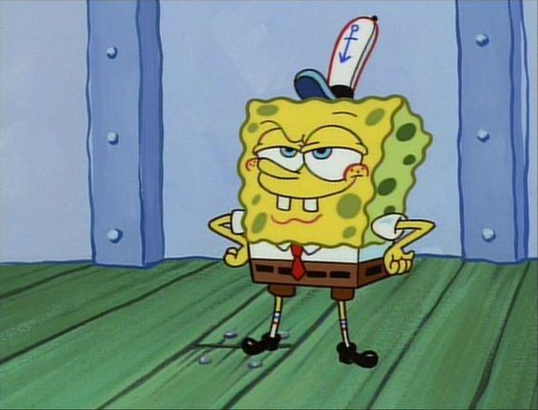
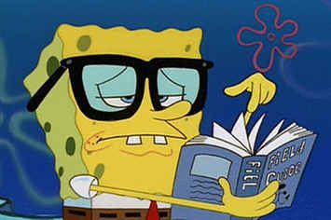
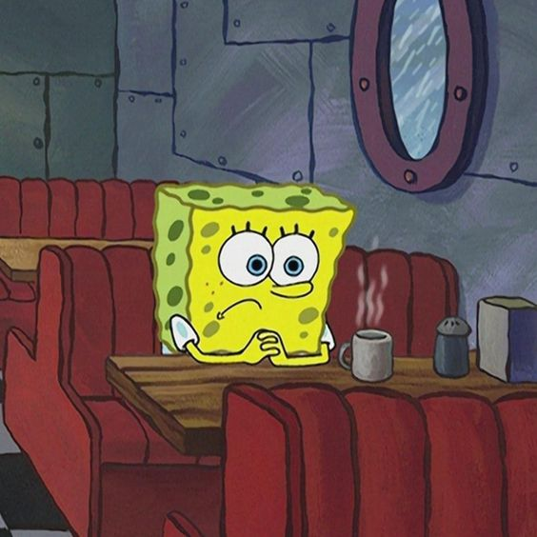
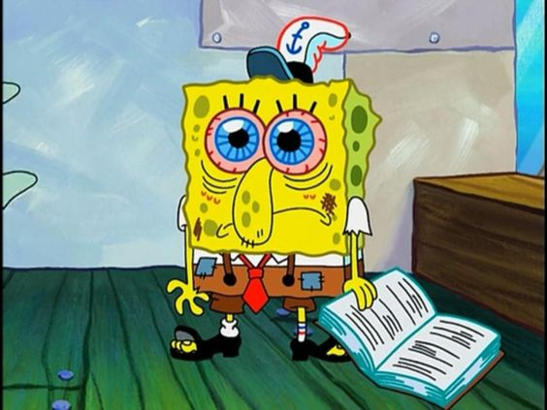
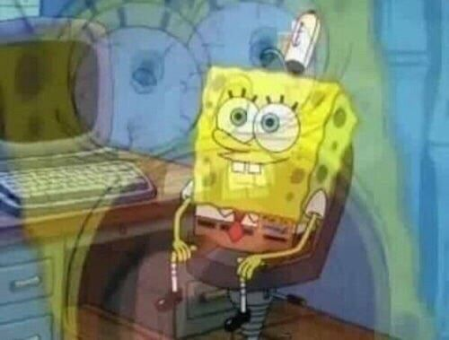
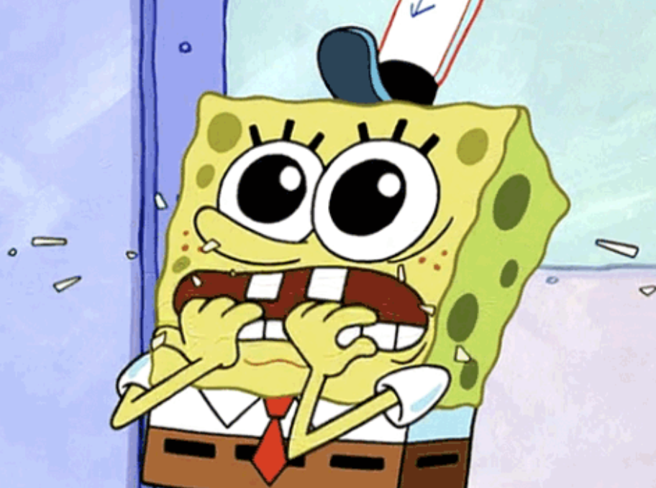
How do you feel about your preparation?
1 2 3
4 5 6

Slide 4
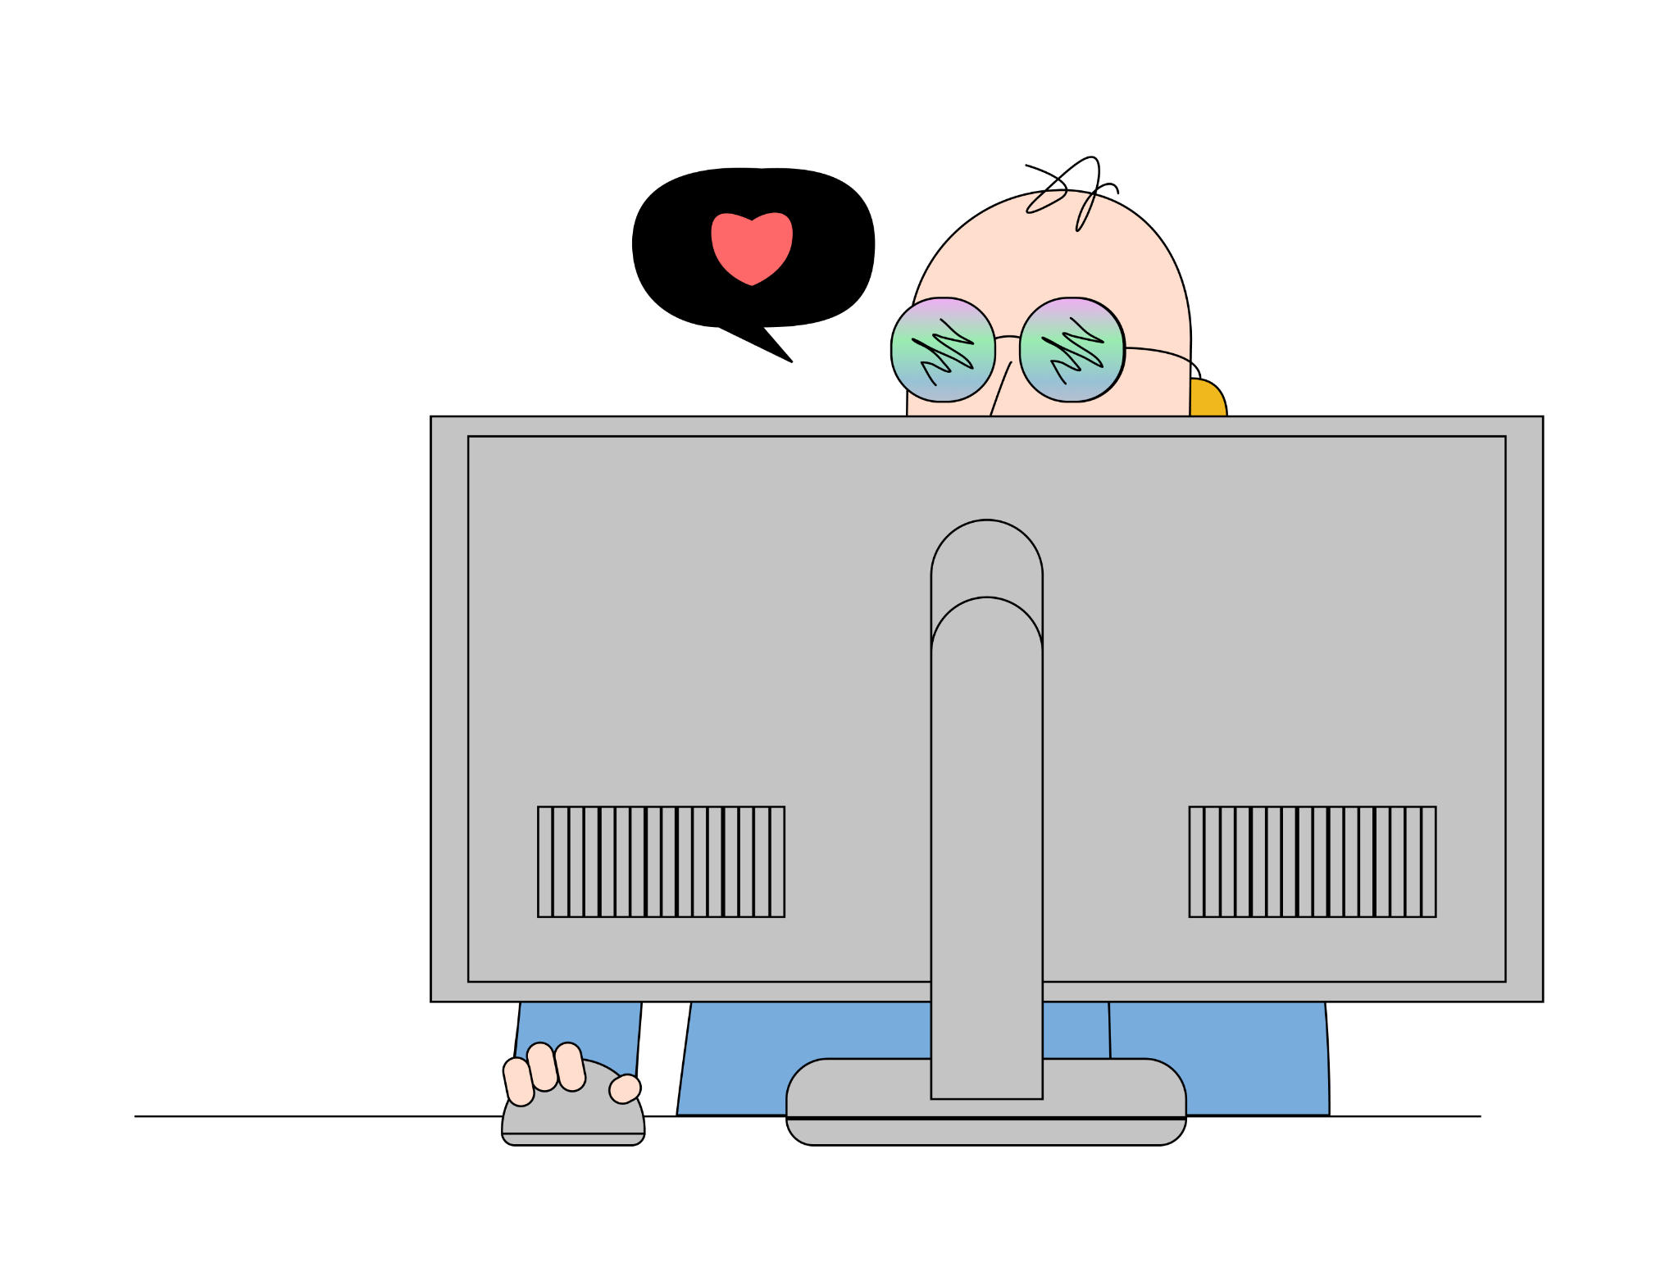
LET’S GET STARTED!

Slide 5
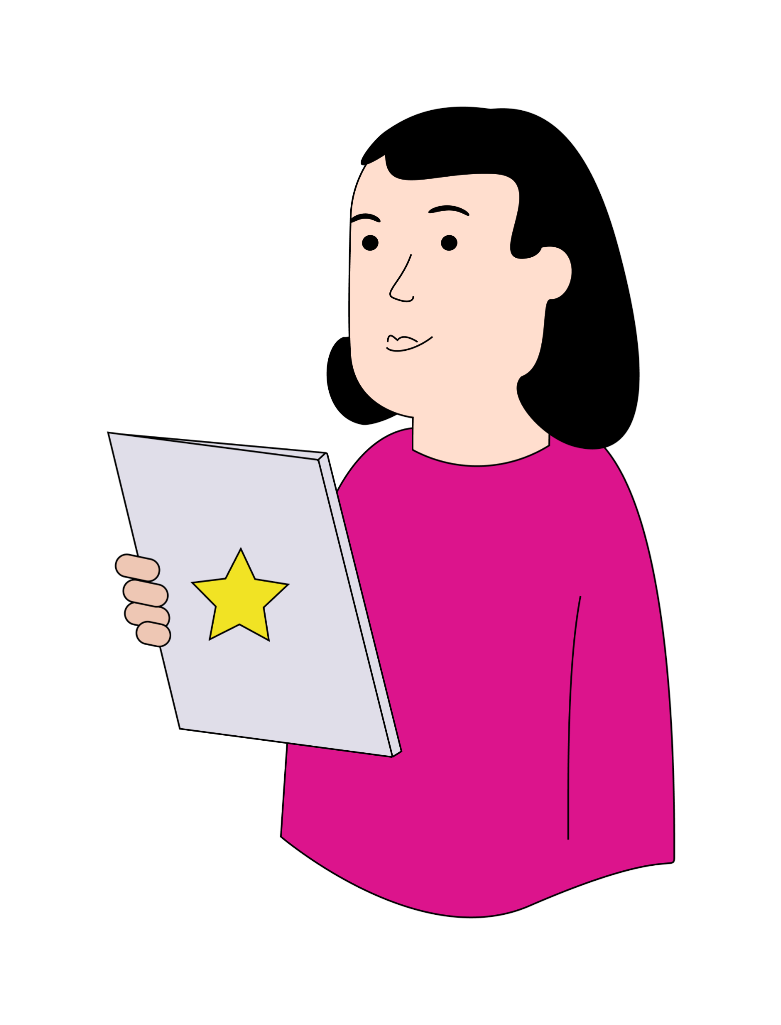
Tell me about yourself

Slide 6
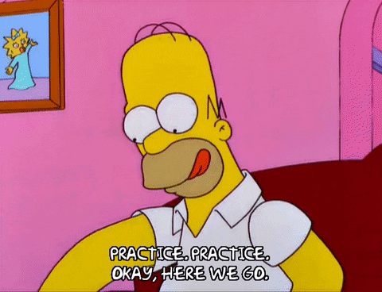
Time for random questions!

Slide 7
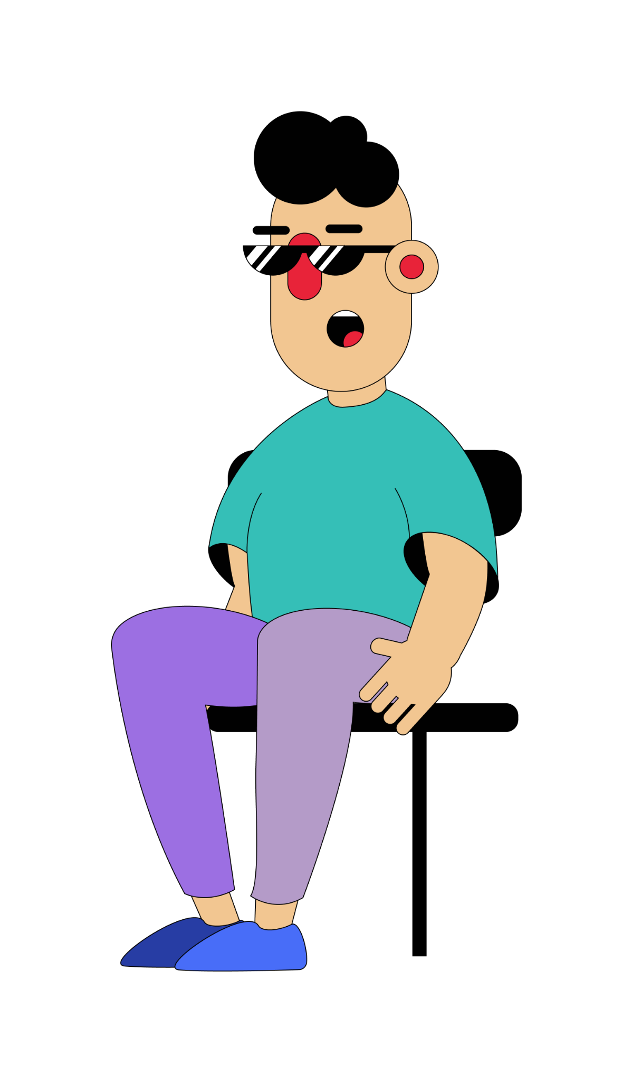
What questions may you ask at the job interview?

Slide 8
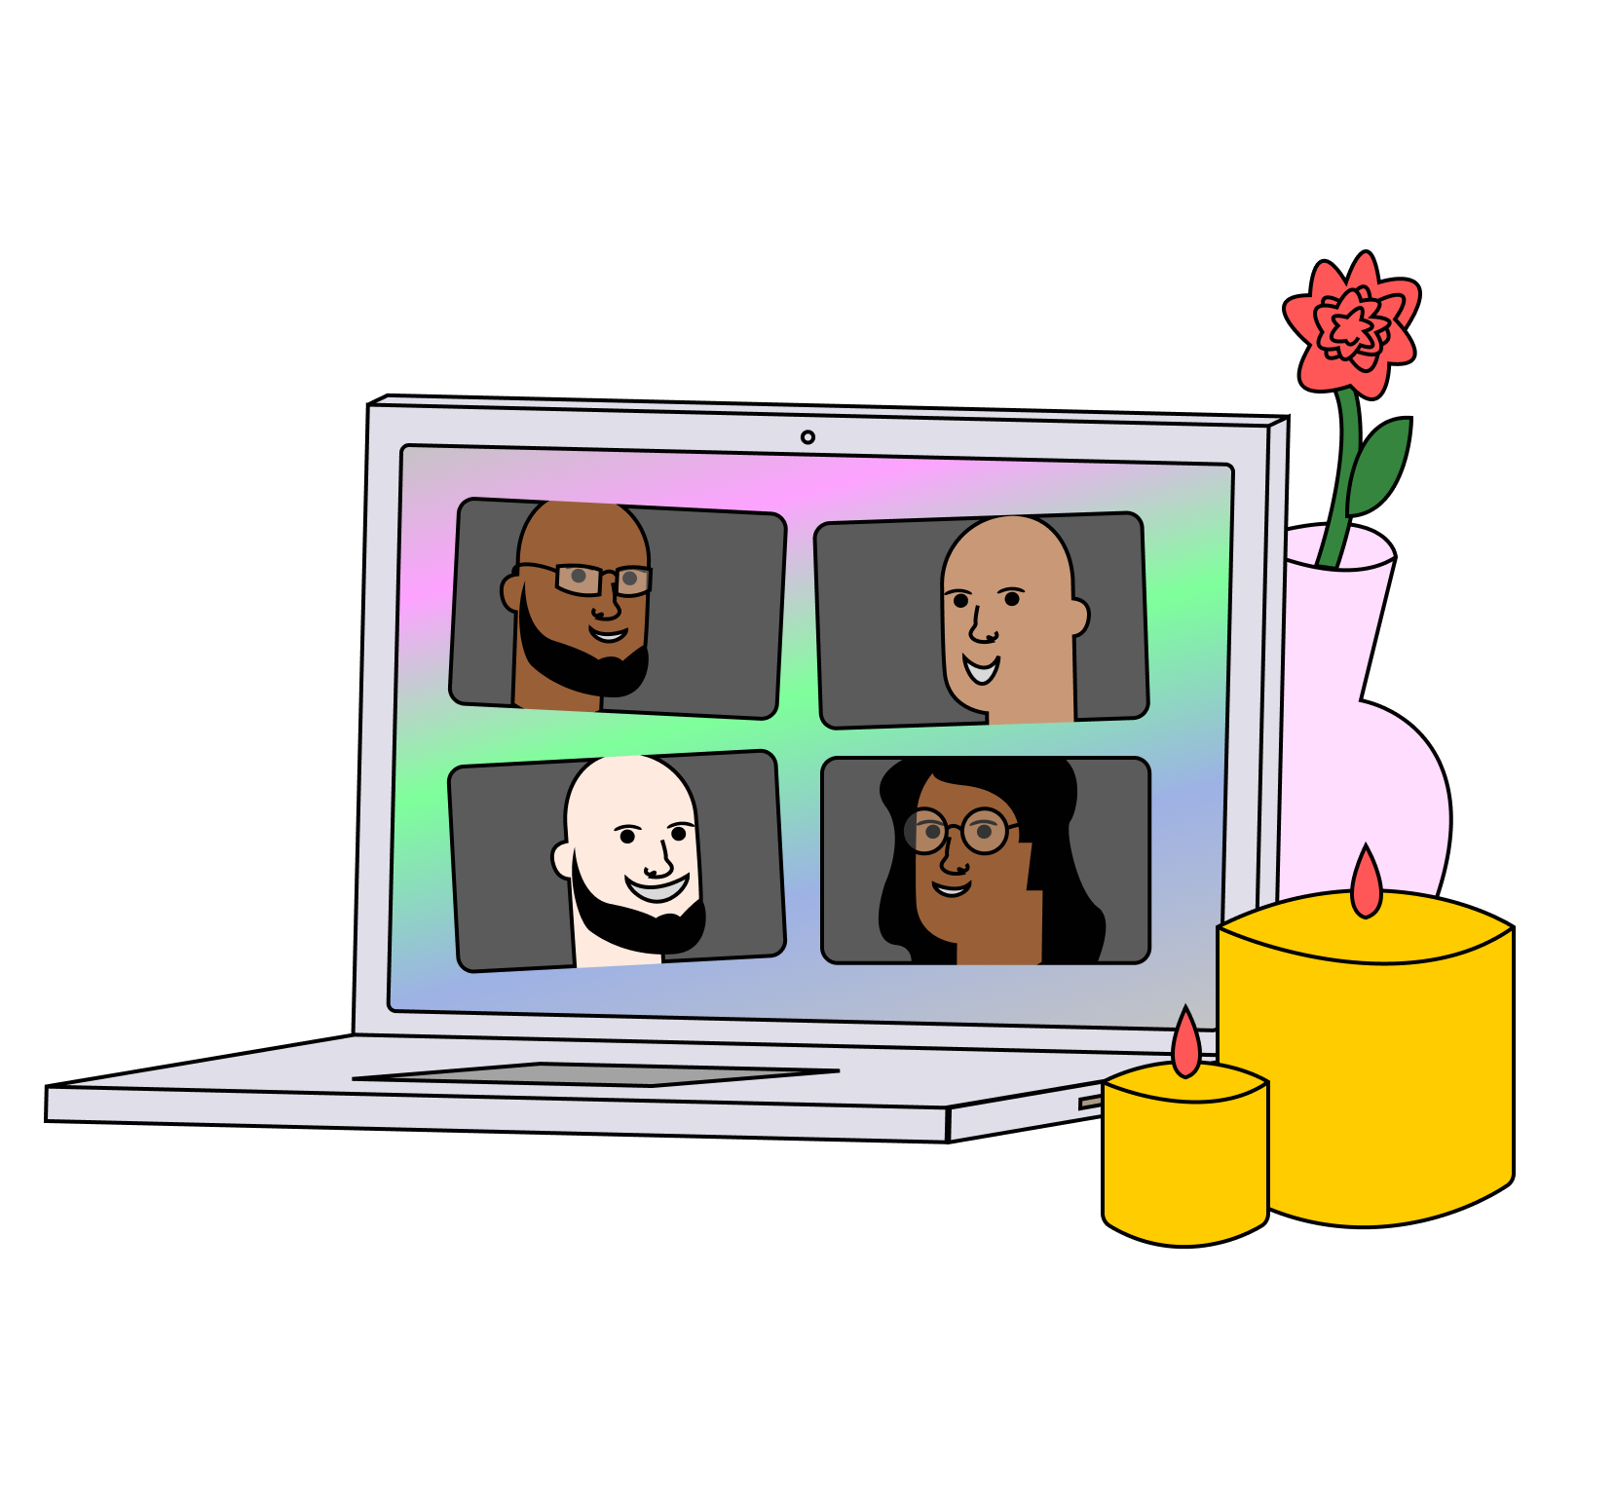
Good job guys!
I am proud of you!
Notes:
https://jamboard.google.com/d/1YjmJEjktnryuXoM45BdEMZytGe2EiFs4-DM_ZiM6IUE/edit?usp=sharing

Slide 9


Slide 10
Useful links:
Tasks:
https://wordwall.net/resource/37740956 - questions
https://jamboard.google.com/d/1YjmJEjktnryuXoM45BdEMZytGe2EiFs4-DM_ZiM6IUE/edit?usp=sharing - group board

Slide 11
Thank you!

